Slide 1
Rolling Back

Slide 2
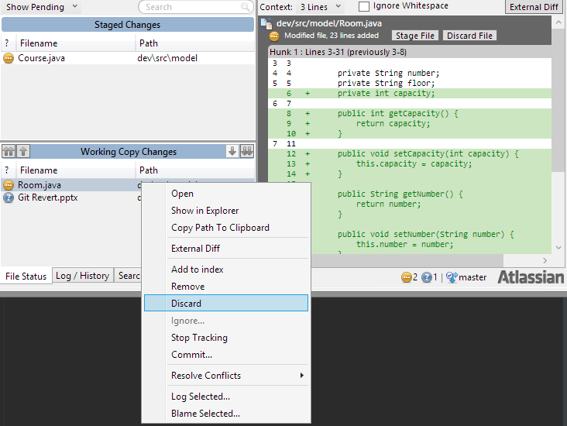
Discard Uncommitted Changes

Slide 3
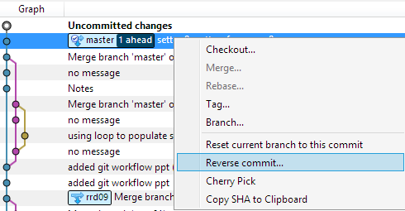
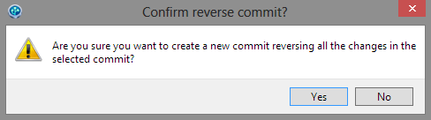
Revert (Reverse Commit)
Revert is a history preserving commit. It changes all involved files into their reverted states)

Slide 4
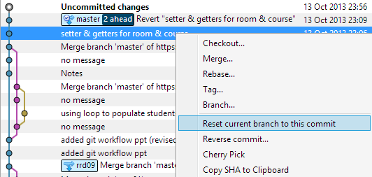
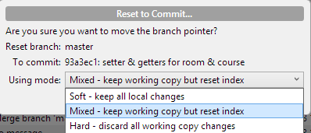
Reset
Careful as all subsequent commits will be lost completely

